Slide 1
MARIA-Demographics and food
Group I
Maria Jadoon
Emily Kuhns
Martel Mann
Coel Locandro

Slide 2
(ALL) Summary
Core message/hypothesis: Demographics effect what Americans eat, how much they spend and how they review restaurants
Describe the questions you asked, and _why_ you asked them
Insert your question:
1. Does income per capita affect the popularity of $$$ and $ restaurants?
2. Martel
3. Coel
4. Does the diversity of the population in a State affect their taste in food?
Describe whether you were able to answer these questions to your satisfaction, and briefly summarize your findings

Slide 3
MARTEL-Questions & Data
Elaborate on the questions you asked, describing what kinds of data you needed to answer them, and where you found it

Slide 4
EMILY- Questions & Data

Slide 5
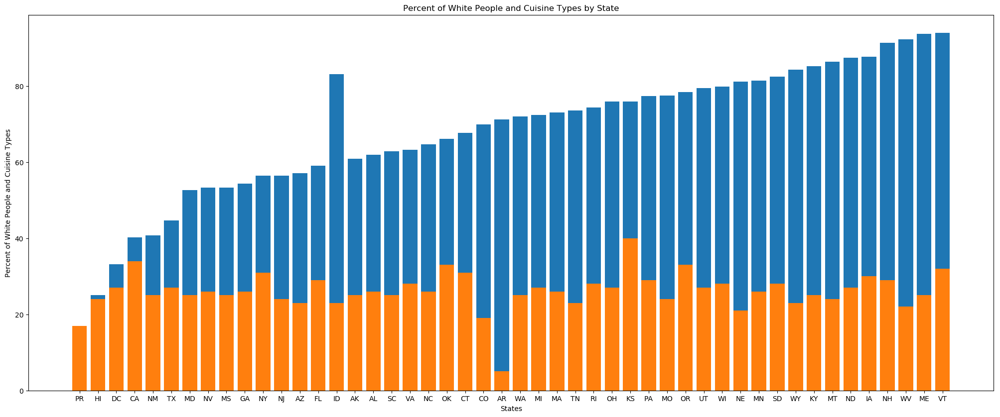
Emily- Does the diversity of the population in a State affect their taste in food?
Discuss the steps you took to analyze the data and answer each question you asked in your proposal
Present and discuss interesting figures developed during analysis, ideally with the help of Jupyter Notebook
Discuss your findings. Did you find what you expected to find? If not, why not? What inferences or general conclusions can you draw from your analysis?

Slide 6
Martel- Data Analysis
Data Analysis
Discuss the steps you took to analyze the data and answer each question you asked in your proposal
Present and discuss interesting figures developed during analysis, ideally with the help of Jupyter Notebook
Discuss your findings. Did you find what you expected to find? If not, why not? What inferences or general conclusions can you draw from your analysis?

Slide 7
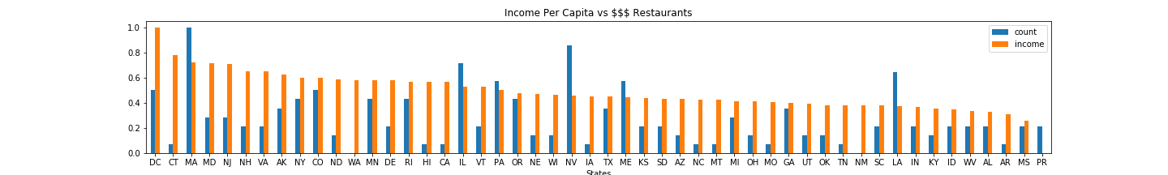
Maria-Does income per capita affect the popularity of $$$ restaurants?
California : Few $$$ restaurants compared to per capita income
Nevada : More $$$ restaurants compared to per capita income
Washington and Puerto Rico : Problem in data collection

Slide 8

Maria-Does income per capita affect the popularity of $ restaurants?
State | $$$ | $
MA | 15 | 3
CA | 2 | 10

Slide 9
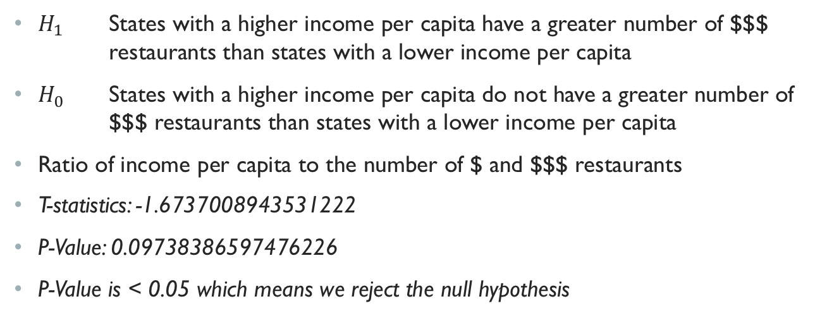
Maria-Income per capital does impact the number of $$$ Restaurants
$H_{1}$ States with a higher income per capita have a greater number of $$$ restaurants than states with a lower income per capita
$H_{0}$ States with a higher income per capita do not have a greater number of $$$ restaurants than states with a lower income per capita
Ratio of income per capita to the number of $ and $$$ restaurants
T-statistics: -1.6737008943531222
P-Value: 0.09738386597476226
P-Value is < 0.05 which means we reject the null hypothesis

Slide 10
COEL- Data Analysis
Data Analysis
Discuss the steps you took to analyze the data and answer each question you asked in your proposal
Present and discuss interesting figures developed during analysis, ideally with the help of Jupyter Notebook
Discuss your findings. Did you find what you expected to find? If not, why not? What inferences or general conclusions can you draw from your analysis?

Slide 11
COEL-Post Mortem
Discuss any difficulties that arose, and how you dealt with them
Discuss any additional questions that came up, but which you didn't have time to answer: What would you research next, if you had two more weeks?

